Slide 1
Neural Networks
Introduction to NN and DNN
Dr. Supriya Patil

Slide 2
What is a Neural Network?
A neural network is a massively parallel distributed processor made up of simple processing units, which has a natural propensity for storing experiential knowledge and making it available for use.
(Brain – Highly complex, nonlinear and parallel information processing system)
Knowledge is acquired by the network from its environment through a learning process. The procedure performing learning process is called a learning algorithm.
Interneuron connection strengths, known as synaptic weights, are used to store the acquired knowledge.

Slide 3
Comparison between Conventional computer and Human brain
Conventional Computer | Human brain
To solve the problem computer uses sequential approach. It follows the set of instructions to solve the given problem. It restricts problem solving ability of computer. | To solve the problem large number of highly interconnected nodes work in parallel. It learns by example. Eg: Small child, experienced doctor.
Computer has centralised control for all the operations. | It is a distributed control system. Each neuron acts based on information locally available and transmits info of its output to neuron connected to it.
Computer stores the information in memory. | Human brain stores information in its connection weights.
Information stored in computer memory is replaceable. | Information stored in human brain is adaptable. Eg: Face recognition.
Computer has no tolerance. If information in memory is corrupt, it can not be retrieved. If one or other part goes the it stops working. Eg: SMPS, RAM, Hard disk. | In biological neural network the information is distributed in the connections through out the network. Even if one or other connection fails or one or other neuron stops working, information can still be retrieved. Still network performs well. Eg: Deaf and dumb person.

Slide 4
Comparison between Conventional computer and Human brain
Conventional Computer | Neural network
Computer is good at arithmetic operations, simple repetitive tasks. Eg: creating graphs, games, to keep track of orders on Amazon | Biological neural network is good at pattern recognition, learning complex techniques, classification problems. Eg: To recognise familiar face it takes 100-200 ms.

Slide 5


Comparison between Conventional computer and Human brain
 | processing elements | element size | energy use | processing speed | style of computation | fault tolerant | learns | intelligent, conscious
 | 10¹⁴ synapses | 10⁻⁶ m | 30 W | 100 Hz | parallel, distributed | yes | yes | usually
 | 10⁸ transistors | 10⁻⁶ m | 30 W (CPU) | 10⁹ Hz | serial, centralized | no | a little | not (yet)

Slide 6
Benefits/Advantages of Neural Networks
The computing power of neural networks
  Massively parallel distributed structure
  Ability to learn and therefore generalize(produce reasonable output for inputs not used during training).
  These two information processing abilities makes it possible for neural network to solve complex problems.
  Advantages of neural networks:
  Highly parallel nature: It improves the speed of the network
  Nonlinearity: Nonlinearity is important property while dealing with the inputs that are nonlinear in nature. Eg: speech signal, biomedical signals etc. An artificial neural network being non linear in nature, plays vital role for modeling many practical applications.

Slide 7
Benefits/Advantages of Neural Networks
Input output mapping: One of the popular paradigm for learning is supervised learning. In supervised learning the input samples (examples) and the desired response, are presented to the network and during the learning network weights get updated. The network learns from the examples by constructing an input-output mapping for the problem at hand.
Eg: Small child, Experienced doctor Vs his doctor son.
Adaptivity: Neural networks have built in capacity to adapt their synaptic weights to changes in the surrounding environment. It makes the task of pattern recognition effective.
Eg: Face recognition of a friend met after 20 years.
Fault tolerance: Neural network is massively parallel distributed computer. Hence even if some neurons or part of network fails. Still network doesn’t lead to complete system failure.
Eg: Blind, Deaf person.

Slide 8
Benefits/Advantages of Neural Networks
  VLSI Implement ability: A massively parallel nature of neural network makes it suitable for VLSI implementation.
  Handles variety of data: Neural network performs better in spite of inconsistent, faulty, missing input data.
  Flexible nature: Its possible to train neural network for short duration or longer duration.
  Real time operations: Its works well for real time applications.
  Eg: Biometric recognitions.
  It works very well with
  a. discovering regularities within the set of patterns.
  b. for large volume of data.
  c. when it is difficult to derive relation between input and output.
  d. It is small compact and dissipates very little power.

Slide 9
Benefits/Advantages of Neural Networks
  It is said that human brain is highly complex, nonlinear and parallel computer. It is an impressive information processor.
  Why not to use such a powerful organization of human brain to build intelligent machines?
  Therefore neural network is invented to model the human brain.
  Aim of ANN: To mimic the human ability to adopt to changing circumstances and current environment. It mainly depends on its ability to learn from the events happened in past and be able tom apply to future situation.
  Eg: experienced doctor and trainee doctor.
  ANN…. Simulated version of human brain.

Slide 10
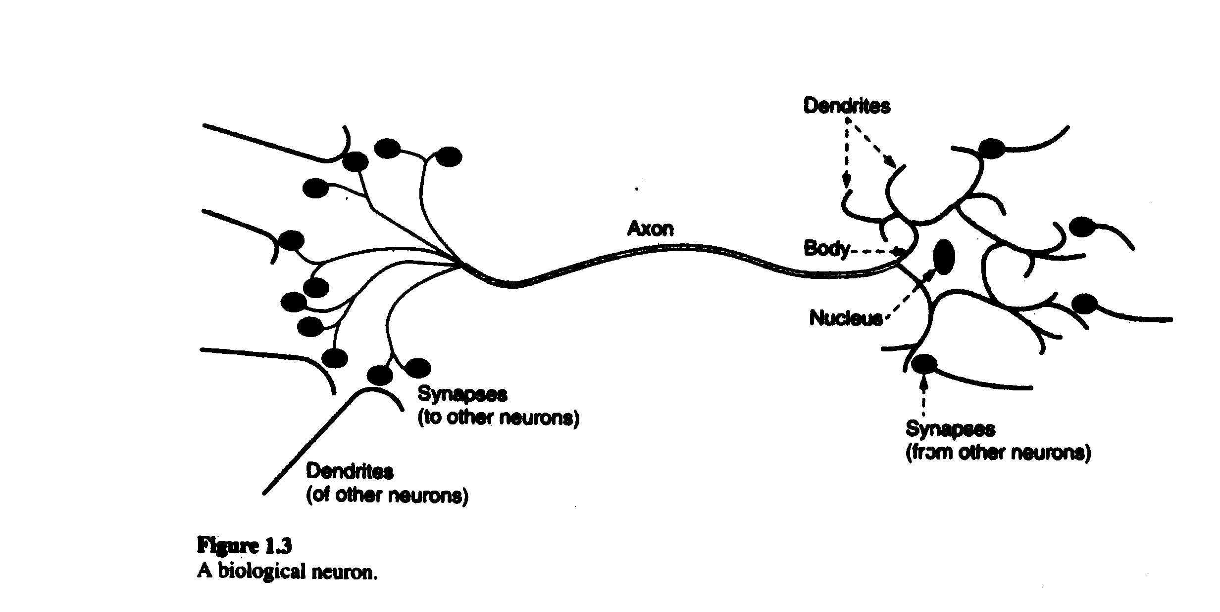
Biological Neuron
There are large varieties of neurons in
brain with different sizes and shapes
Receives the info from other neurons
Processes the inputs
Turn processed inputs into outputs
Electro mechanical contact between neurons

Slide 11
Biological Neuron
Composed of
Cell body (soma)
Tubular axon (output) which further branches in to a number of synapses connected to neighboring neurons.
Multiples of input dendrites connected to synapses of neighboring neurons by synaptic junctions.
Output of the neuron is in the form of electric pulse which travels down the axon to synaptic junctions.
Synapses mediate interaction between neurons, convert pre-synaptic electric signal in to chemical signal and post synaptic chemical signal in to electric signal.
Effect is to raise electrical potential within the cell.
When the net potential exceeds a threshold the cell fires and output in the form of electric impulse travels down the axon to synapses of other cells.

Slide 12
Biological Neuron
Whenever neuron membrane potential exceeds threshold level (normally 40mv), it generates the train of pulses and neuron fires.
If incoming impulses are causing firing, they are called as excitatory and if incoming impulses are opposing the firing of neuron, they are called inhibitory.
After firing neuron goes into complete non excitability state for certain amount of time. This period is called Refractory period. It is different for different neurons.

Slide 13
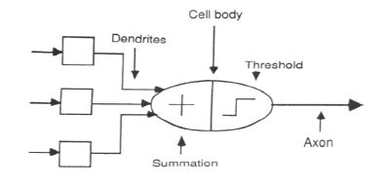
Artificial Neuron
Biological Neuron Artificial Neuron
Cell body Neuron
Dendrites Connection weights
Axon Output

Slide 14
Artificial Neuron Model (MC-Culloch Pitts)
It consist of input connections, processing unit, threshold logic unit and bias element.
Synaptic connections are characterised by connection weights.
bk
The weights can be negative or positive.
Some times external bias bk is used.
The output of neuron is given by,
y = f(net) = f(net+bk)
= 1 if net+bk >= T
= 0 if net+bk < T
Neurons perform nonlinear operation through its activation function.
w1
x1
w1x1
w2
∑
x2
w2x2
∑
net
T
f(net)
wn
wnx
xn

Slide 15
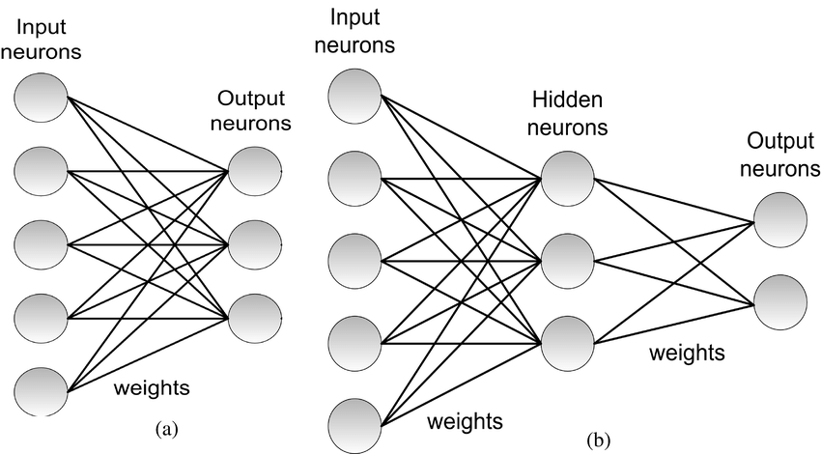
Architectures of Neural Network
Single layer neural network Multilayer neural network

Slide 16
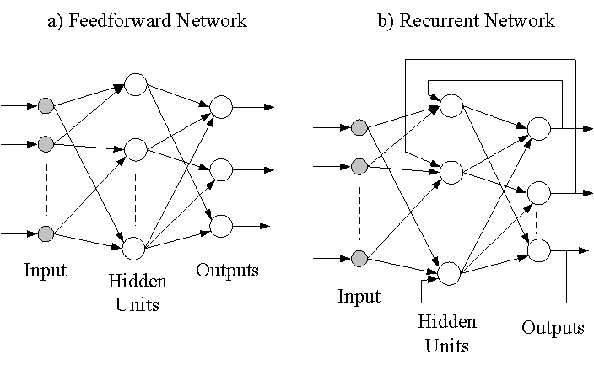
Architectures of Neural Network

Slide 17
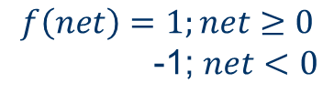
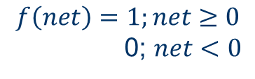
Activation or Stochastic Functions
Activation Function | Graph | Equation
Discrete Unipolar/ Unipolar Binary/ Hard Limit Unipolar
Discrete bipolar/ Bipolar Binary/ Hard Limit Bipolar
f(net)
$$f\left(net\right)=1;net≥0$$
0; $net<0$
0
net
f(net)
1
$$f\left(net\right)=1;net≥0$$
-1; $net<0$
0
net
-1

Slide 18
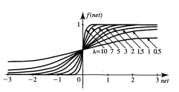
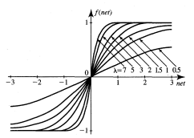


Activation or Stochastic Functions
Activation Function | Graph | Equation
Continuous Unipolar/ Unipolar Sigmoid/ Soft limit unipolar
Continuous bipolar/ Bipolar Sigmoid/ Soft limit bipolar
$$f(net)=\frac{1}{1+exp⁡(−λnet)}$$
$$f(net)=\frac{1−exp⁡(−λnet)}{1+exp⁡(−λnet)}$$

Slide 19
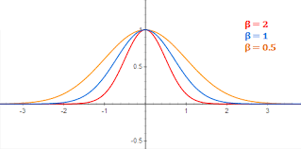

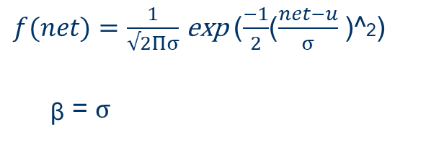
Activation or Stochastic Functions
Activation Function | Graph | Equation
Linear
Gaussian
f(net)
$$f\left(net\right)=net$$
0
net
f(net)
$f(net)=\frac{1}{√2Πσ}$ exp ($\frac{−1}{2}$($\frac{net−u}{σ}$ )^2)
ᵦ = $σ$
net

Slide 20
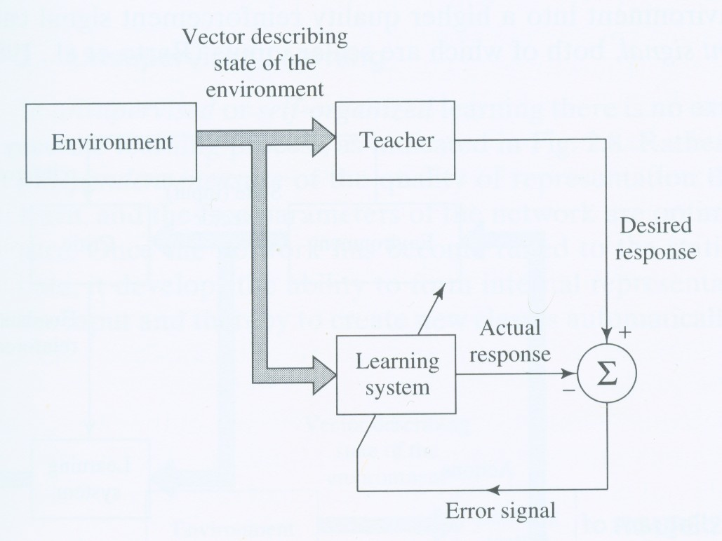
Types of Learning: 1.Supervised Learning
Given: Input samples and desired outputs.
The input samples are presented to network and actual output is calculated.
The error between actual and desired output is calculated.
This error is used for weight updating iteratively in step by step manner.
Training stops when error for all pattern becomes 0 over the iterations (When actual and expected outputs match for all patterns over number of iterations).
Applications: pattern classify-cation, function approximation
Explain about error curve.

Slide 21

2. Unsupervised Learning
Given: Input patterns
It is carried out in absence of teacher.
Desired response is unknown. No information is available to correct the response.
The network modifies the weights depending on observations of the responses of the output.
The weights are adjusted in such a way that most similar input patterns are assigned to same output unit.
The training is complete when the patterns starts getting classified to same class over number of iterations.

Slide 22
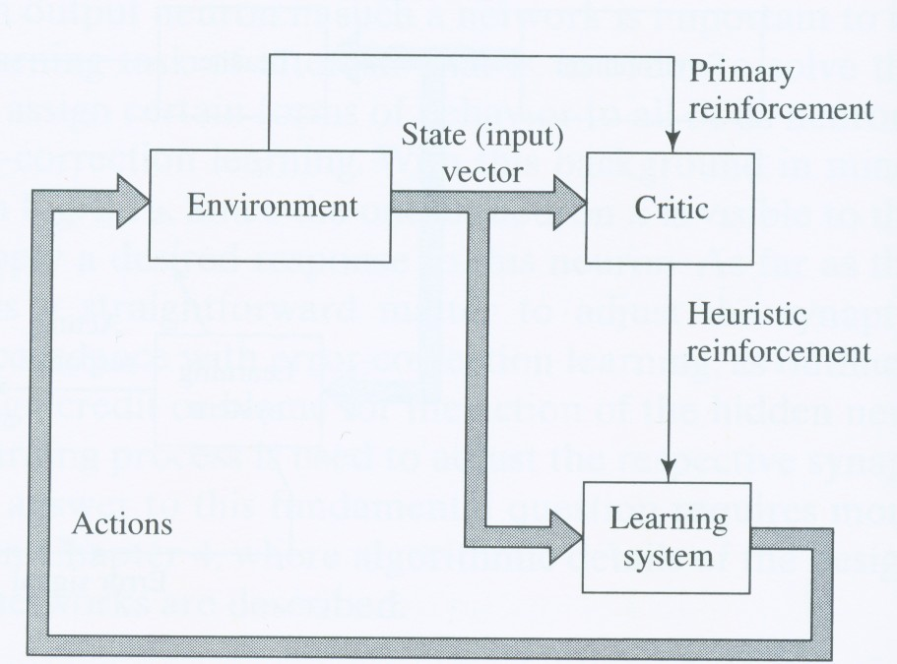
3. Reinforcement Learning
I/O mapping is performed through continued interaction with the environment to minimize a scaler index of performance.

Slide 23
Learning Rules
Learning | Single weight adjustment | Initial Weights | Learning | Neuron Characteristics | Neuron/ Layer
Hebbian | c*f(neti)* Xi | 0 | Unsupervised | Any | Single neuron
Perceptron | c*(di-f(neti))*Xi | Any | Supervised | Discrete | Single neuron
Delta | c*(d-f(neti))*f’(neti)* Xi | Any | Supervised | Continuous | Single neuron
Widrow-Hoff | c*(di-neti)*Xi | Any | Supervised | Any | Single neuron

Slide 24
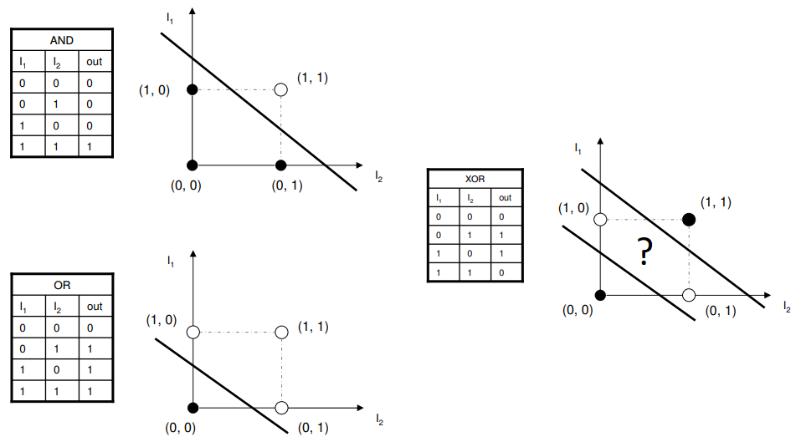
Linear and Nonlinear Separability

Slide 25
Linear and Nonlinear Separability
For two class classification problems if it is possible to choose single straight line separating the patterns, it is called linearly separable classification problem.
For two class classification problems if it is not possible to choose single straight line separating the patterns, it is called non linearly separable classification problem.
Limitation of single neuron: Can solve only linearly separable two classification problem.

Slide 26
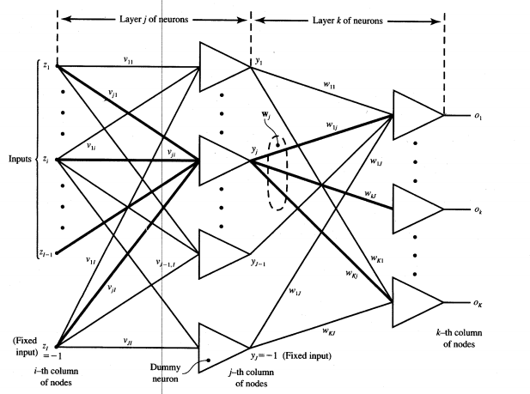
Multilayer Neural Network:
Error Back Propagation algorithm (EBPA)

Slide 27
Error Back Propagation algorithm (EBPA)
It is supervised algorithm.
It works only for continuous neuron.
Its algorithm for multilayer neural network.
Goal: To modify the weights in such a way that output vector is as close as possible to desired output vector.

Slide 28
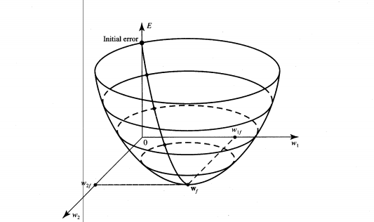
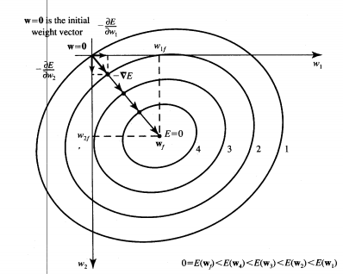
Ideal Error Curve
Wf= final weights

Slide 29
Error Back Propagation algorithm (EBPA)
Network Architecture:
It has input layer(zI), hidden layer (yI neurons) and output layer (oK neurons).
vji are the connection weights from input layer to hidden layer and wkj are connection weights from hidden layer to output.
The number of hidden layers can be more than one and number of neurons in every hidden layer can be different.
Every neuron in the network can have different activation function of number of neurons can have same activation function.

Slide 30
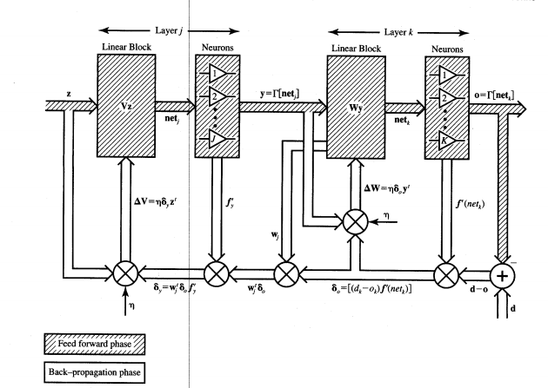
Error Back Propagation algorithm (EBPA)

Slide 31
Error Back Propagation algorithm (EBPA)
In the diagram shaded area shows forward pass and plain area shows backward pass.
The signal moves in the forward direction while the error moves in the backwards.
Why the name EBPA?
Each output unit compares actual output with expected output to determine associated error for that pattern. Based on the error ɗk factor is calculated and it is used to distribute the error at the output layer back to all units in the previous layer.

Slide 32
Error Back Propagation algorithm (EBPA)
Random values are chosen for hidden layer and output layer connection weights.
Outputs of hidden layer nodes are determined on basis of input patterns and assumed connection weights of hidden layers.
Outputs of output layer nodes are determined on the basis of outputs of hidden layer nodes and assumed connection weights for output layer.
Weights of output layer are updated first based on gradient descent rule applied to output nodes.
Followed by updating weights of hidden layer based on gradient descent applied to hidden node.
Process repeated till convergence is reached. (error within limits).

Slide 33
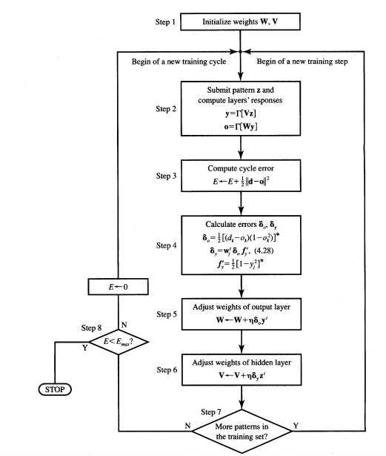
EBPA Flowchart

Slide 34
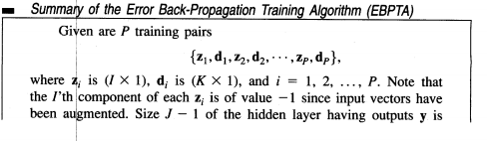
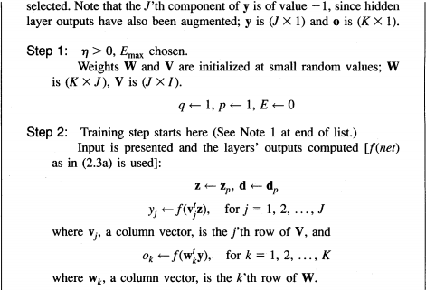
EBPA working

Slide 35
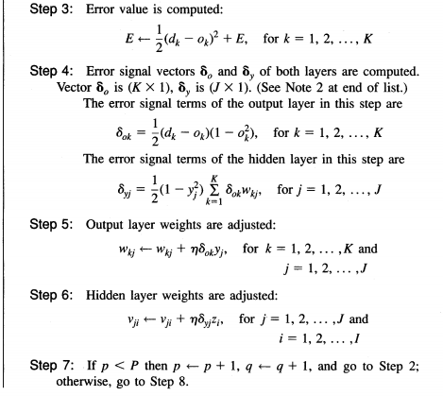
EBPA working

Slide 36
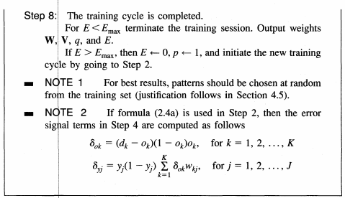

EBPA working

Slide 37
Design Considerations for EBPA
Initialization of weights:
Initial weights randomly chosen between +1 and -1 or +0.5 and -0.5.
Larger weights drives network into saturation requiring larger training time.
magnitudes of some inputs are larger than others network may get biased to give more importance to inputs with larger magnitudes.
Weights are initialized such that effective input to each hidden node is same.

Slide 38
Design Considerations for EBPA
Choosing of learning constant
Magnitude of weight change depends on learning rate.
Larger learning rate- Rapid learning but network may oscillate.
Smaller learning rate- Slow learning. Longer time to stabilize.
Right value- Lies between 0.1 and 0.9.

Slide 39
Design Considerations for EBPA
For efficient learning-
Begin with larger rate and slowly decrease as network reaches convergence.
Begin with small value and increase at iteration that improves performance and decrease at iteration that degrades performance.
Use second derivative of error to determine rate.
Small second derivative – Permits larger step size or larger learning rate.
Large second derivative - Dictates smaller step size or smaller learning rate.
WRITE AS EXPLAINED IN THE CLASS

Slide 40
Design Considerations for EBPA
Number of samples:
Thumb rule –
Number of samples = 5 to 10 times the number of weights to be trained.
Baum & Haussler – (Necessary condition)
Number of samples P > |W| / (1-a)
where P = size of training set,
W = No of weights,
a = required accuracy
Eg: With 27 weights and 95% accuracy number of samples needed = 540.
Modified rule – (Sufficient condition)
P > {|W| / a} log{n / (1-a)} where n = number of nodes.

Slide 41
Design Considerations for EBPA
Frequency of updating
Per pattern learning | Per epoch learning
Weights are changed after every sample. | Weights are changed only after all training samples are presented to the network.
Expensive and requires more computational power. | Cheap and requires less computational time.
Most suitable for online applications. | Not suitable for online applications.

Slide 42
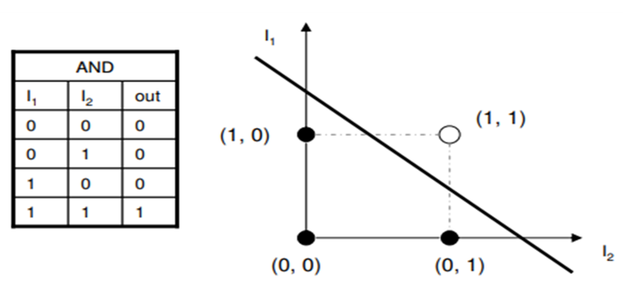
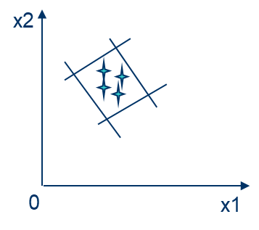
Design Considerations for EBPA
Number of nodes
With few nodes network is not powerful.
With large number of nodes computation is expensive and generalization is poor.
No method for determining optimum no of nodes.
For two classes a single node needed.
For convex region with 4 decision planes four nodes in first layer
(hidden layer nodes) and one node in second layer needed.
For three such regions 12 nodes in first layer (hidden layer nodes) and 3 in second layer needed.

Slide 43
Design Considerations for EBPA
Number of nodes
In general –
Number of input nodes = number of elements in input vector
Number of output nodes = number of classes
Number of hidden nodes choose by trial and error method.

Slide 44
Performance Evaluation of EBPA
Processing Time
It depends on… no of weights to be trained
learning constant
no of nodes
no of input samples
complexity of activation function etc

Slide 45
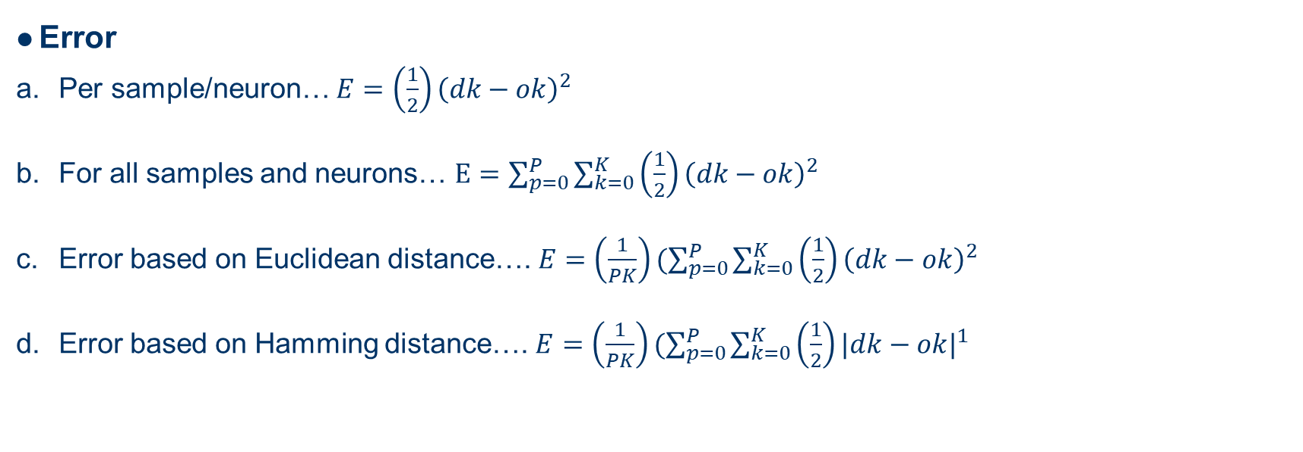
Performance Evaluation of EBPA
Error
Per sample/neuron… $E=\left(\frac{1}{2}\right){\left(dk−ok\right)}^{2}$
For all samples and neurons… $E=\sum_{p=0}^{P}{\sum_{k=0}^{K}{\left(\frac{1}{2}\right){\left(dk−ok\right)}^{2} }}$
Error based on Euclidean distance…. $E=\left(\frac{1}{PK}\right)(\sum_{p=0}^{P}{\sum_{k=0}^{K}{\left(\frac{1}{2}\right){\left(dk−ok\right)}^{2} }}$
Error based on Hamming distance…. $E=\left(\frac{1}{PK}\right)(\sum_{p=0}^{P}{\sum_{k=0}^{K}{\left(\frac{1}{2}\right){|dk−ok|}^{1} }}$

Slide 46
Performance Evaluation of EBPA
Implementation
Hardware | Software
It offers significant increase in speed. | It has lesser speed as compare to hardware
It does not allows weights of all magnitudes. | It does allow weights of all magnitudes.
It is difficult to implement and debug network with higher connectivity. | It is easy to implement and debug the network with higher connectivity.
Used when network is smaller and more speed is required. | Used when network is larger and speed does not matter.

Slide 47
Performance Evaluation of EBPA
Generalizability
System must perform well on test data other than training data.
Excessive training on training data decreases performance on test data.
Solution-To constantly monitor performance on test data.
Training continues as long as error on test data continues to decrease and is terminated if test data error increases even if training data error continues to improve. Eg: VLSI chip fabrication process.
Test samples
Error
Training samples
No of epochs

Slide 48
Local Minima Problem of EBPA
Ideal error curve is parabolic in nature but practical error curve has number of local minima’s.
Aim of training the network is to reach to global minimum without getting stuck in the local minimum.
During training network gets stucked at local minimum as gradient is zero at the point and it is assumed that training in complete which is false.
To avoid the network getting stucked in local minimum it is required to average out the practical error curve.
Mathematically averaging is expensive task.
Therefore momentum term is included in the weight update formula to give same effect as averaging.
Local minimum
Error
Global minimum
No of Epochs

Slide 49
Local Minima Problem of EBPA
To avoid drastic fluctuations in weight changeover consecutive iterations, the Momentum term is included in the weight update formula as given by,
The effective weight change is an average of change suggested by current gradient and weight change used in previous gradient
α is Momentum factor. Normally …0 < α < 1, typically α = 0.9
Adding Momentum term leads to faster convergence and better stability.
When sign of gradient does not change, Momentum term increases the amount of weight change and speeds up on shallow gradient.
When sign of gradient changes, Momentum term decreases the amount of weight change and oscillations will reduce.

